Slide 1

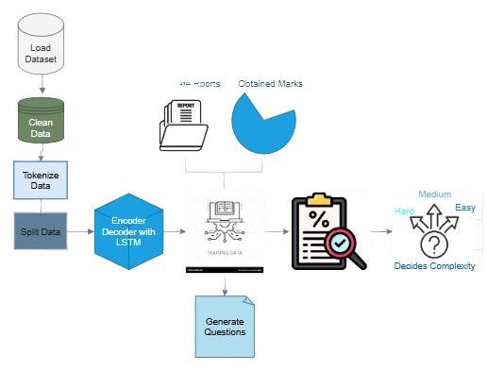
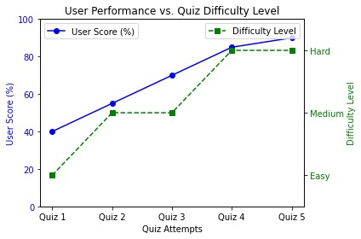
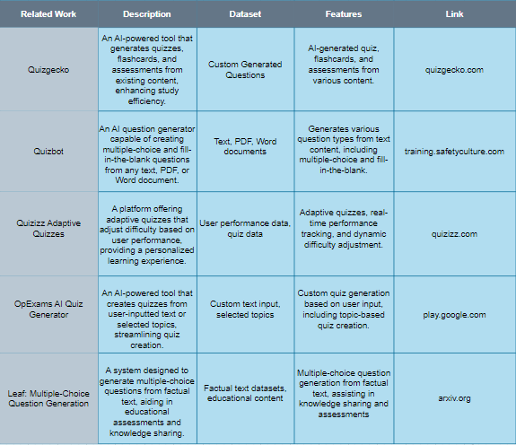
AI Adaptive Quiz Application
Members: Umaima Noor(2022-CS-147),Minahil Afzal(2022-CS-159)
Instructor: Sir Samyan Qayyum Wahla
University of Engineering and Technology, Lahore
Abstract
Goals and Objectives
Proposed Methodology
This project presents an AI-Powered Adaptive Quiz Application designed to revolutionize learning through intelligent assessment and personalized feedback. Traditional quiz systems often lack the ability to dynamically adapt to individual performance, reducing their impact on skill development. This application employs a sequence-to-sequence machine learning model with an encoder-decoder architecture to generate adaptive quizzes tailored to user proficiency. The model leverages tokenization and embedding layers for processing quiz data and dynamically adjusts the difficulty (Easy, Medium, Hard) based on previous scores.
The system is developed using React.js for the frontend, PHP for the backend, and MySQL for database management, ensuring seamless interaction and data security. It supports quizzes across various technologies, including Linux, Java, and Python, and provides users with features to track performance trends, view results, and generate PDF reports. This scalable and interactive solution integrates state-of-the-art AI techniques, making it an ideal tool for fostering skill development in educational and professional environments.
Goals: Develop an AI-powered quiz platform that provides personalized learning experiences, tracks user progress, and generates detailed feedback through dynamic reports. Objectives:
Implement secure sign-in/sign-up functionality for personalized experiences.
Generate adaptive quizzes based on user preferences and performance.
Allow users to view quiz history, scores, and performance metrics.
Generate PDF reports with feedback, scores, and improvement areas.
Adjust quiz difficulty based on user performance to optimize learning.
Use user data to improve quiz generation and performance predictions.
Ensure seamless communication between React frontend and Node.js backend.
Develop a flexible architecture to support future feature expansions and growth.
Quiz App: User Progression Across Difficulty Levels
Introduction, Background Motivation, Problem Statement
Related Work
In modern education, interactive and personalized learning experiences are vital for student engagement and skill acquisition. Traditional quiz systems often employ static difficulty levels, which fail to address individual learning needs. To overcome this, we propose an AI-powered adaptive quiz application that personalizes assessments based on student performance. Key features include dynamic difficulty adjustment, real-time performance tracking, detailed analytics, and multi-topic support across technologies like Linux, Java, and Python. By offering adaptability and insightful feedback, this application stands out from traditional systems. Its use of machine learning ensures that students receive tailored challenges, improving engagement and learning outcomes. The rapid advancements in technology and the growing need for personalized education highlight the importance of adaptive learning tools. Static quiz systems do not provide meaningful insights into student progress or adapt to their strengths and weaknesses. This project is motivated by the need to transform traditional education methods into interactive, data-driven experiences. By integrating AI-driven adaptability and comprehensive analytics, this solution enables both students and educators to achieve more effective and engaging learning experiences. Conventional quiz systems are limited in their ability to adapt to varying levels of student proficiency, resulting in ineffective assessments and reduced learning outcomes. Students often disengage when quizzes are either too easy or too challenging, and educators lack the tools to analyze performance trends comprehensively. This project addresses these issues by developing an adaptive quiz system that adjusts difficulty levels dynamically, tracks performance, and provides detailed analytics to both students and educators. The goal is to create a scalable, efficient, and user-friendly solution that revolutionizes educational assessments and enhances overall outcomes.
Results and Future Work
The AI-driven quiz application demonstrated promising results in generating quizzes tailored to individual user profiles, enhancing engagement and learning outcomes. Performance metrics, including accuracy and user satisfaction, were evaluated across various iterations, showing that the system effectively tracks progress and adjusts question difficulty based on user performance. The analysis revealed a positive correlation between personalized quiz content and improved user results, though challenges remain in refining question generation and real-time feedback mechanisms.
Ultimately, the system provides a scalable, personalized learning experience with strong potential for improving educational engagement. Future work will focus on optimizing AI algorithms for more accurate question generation, expanding the dataset for broader topic coverage, and enhancing the user interface. Additionally, integrating adaptive learning techniques and real-time feedback will further enhance the system's effectiveness and user satisfaction.
Dataset
The dataset used in the AI-Powered Quiz Application is of programming questions consists of 110,741 entries with three key columns: instructions, input, and output. This dataset offers: Challenging Questions : Immerse your language models in various Python programming questions designed to stimulate cognitive growth.
Real-world Inputs : Provide your models with authentic input scenarios, ensuring they are well-equipped to handle practical coding challenges.
Accurate Answers : Sharpen the precision of your language models by exposing them to meticulously crafted Python code solutions. 13,077 unique instructions and 12,997 unique outputs, show casing minimal repetition and comprehensive coverage of topics.
Contact
Email: umaimanor42@gmail.com
Website: noor.com
Phone:0305433306

